Slide 1
Oakland Inconvenience Tracker
Dylan Sporrer, David Rowan, Brandon Donahue, Adam Farabaugh
S

Slide 2
Overview and Terms
Overview
Web Application
Users List and Vote On Inconveniences Around Campus
Live Map displays location of inconveniences in relation to eachother
Tag system helps in finding issues relevant to user
Terms
Inconvenience – An issue preventing transit, normal class schedule, etc. on campus
Listing - A single instance of an inconvenience and its info
S

Slide 3
Tools and Dependencies
Tools and Languages
.NET and C#
Visual Studio
External Dependencies
Google Maps API in use for live map feature
Amazon Web Services in user for web hosting
D

Slide 4
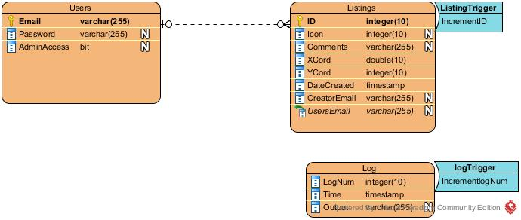
Database Diagram
R

Slide 5
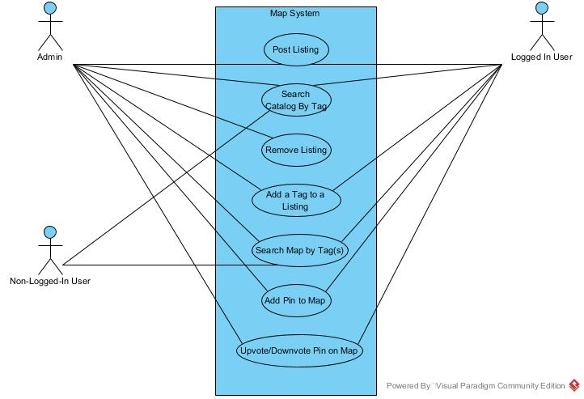
Use Case Diagram: Primary Functions
Users separated by set of associated permissions
D

Slide 6
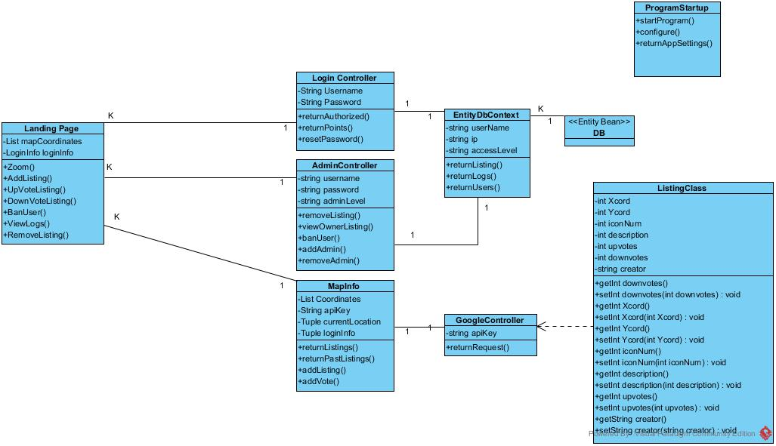
Class Diagram
Landing page class acts as point of communication with other classes
R

Slide 7
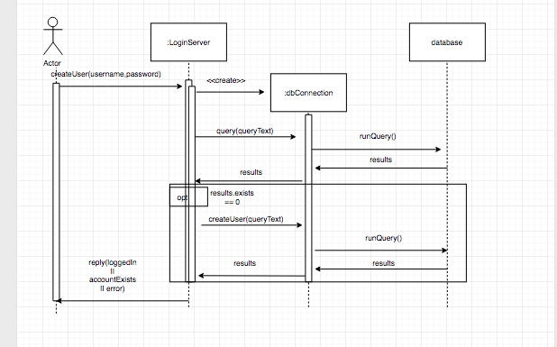
Sequence Diagram: Profile Creation
F

Slide 8
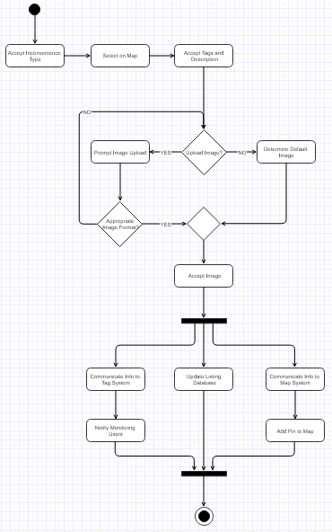
Flow Diagram: Create Listing
Listing Creation Updates Map and Tag Systems as well
S

Slide 9
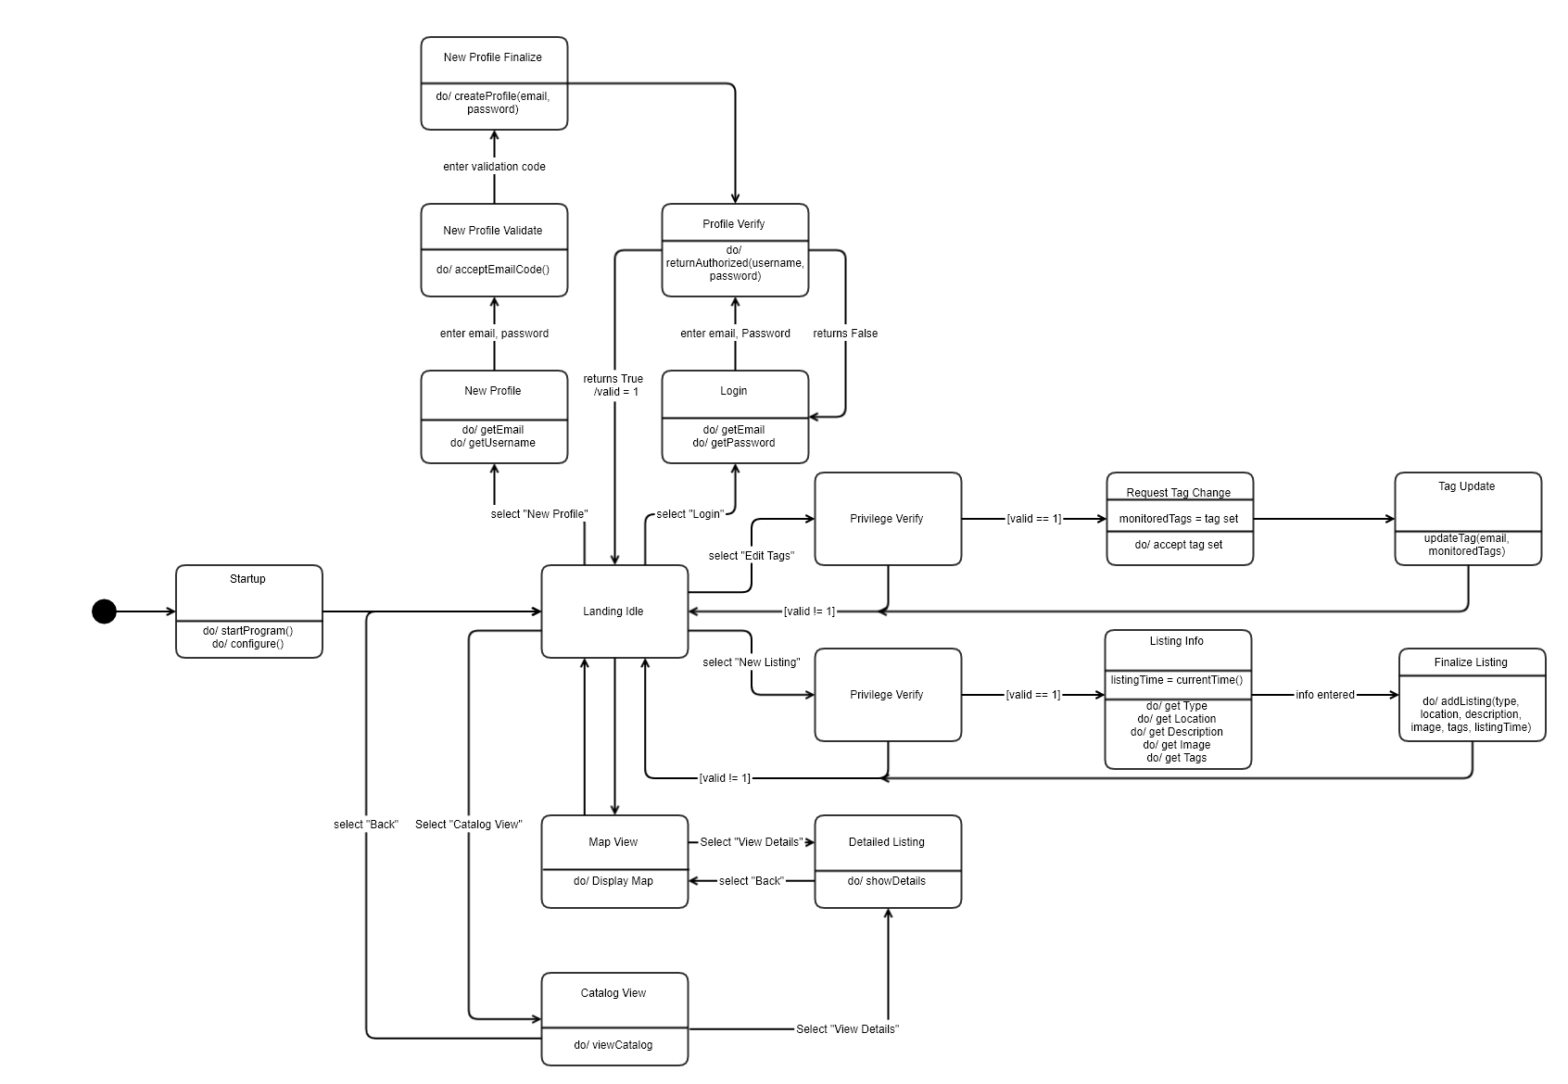
State Diagram: Complete System
Central Landing Page Idle State
No exit in normal operation
States to determine user permission set
S

